Slide 1
WEEK #2
WRITING BUILDING BLOCKS:
Sentences, Phrases and Clauses

Slide 2
Words
Phrases
Clauses
Sentences
Paragraph
Essays/compositions

Slide 3
PHRASES
A phrase is a group of words that does not have a subject and a verb. A phrase is a meaningless alone.
For Example:
In the evening
A sincere and honest leader
In early nineties
Extremely beautiful

Slide 4
NOUN PHRASE
has noun or a pronoun
Steve and Tom
Big dogs
ADJECTIVE PHRASE
has adjective
She has long hair.
Their house is extremely beautiful.
TYPES OF PHRASE
ADVERB PHRASE
has adverb
He got out of bed very slowly.
Please walk more quickly.
VERB PHRASE
has a main verb and one more helping verb
I have read books.
Tina should have known what to do.
PREPOSITIONAL PHRASE
has a preposition and one or more nouns or pronouns as their modifiers
The car with the dents is mine.
Most of the pie has been eaten.

Slide 5
ACTIVITY IS ON PAGE NUMBER 4.

Slide 6
CLAUSE
A Clause is a group of words with a subject and a verb that functions as a part or all of a complete sentence.
For Example:
I have books.
You look beautiful.

Slide 7
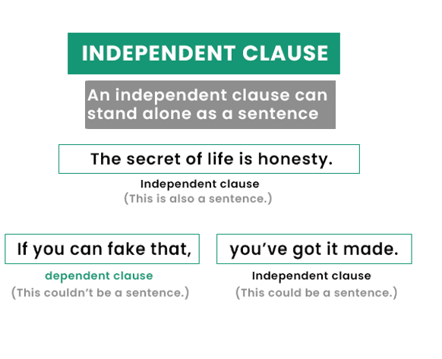
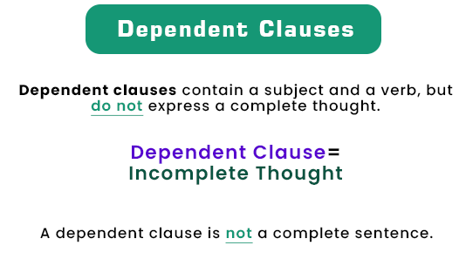
Sabrina plays the guitar.
The manager is not at fault.
Since Ahmed came home, his mother has been happy.
Sana stayed in the game because she was needed.

Slide 8
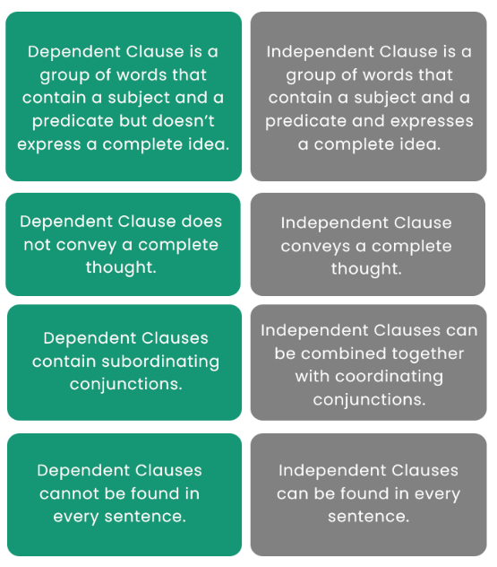
DEPENDENT CLAUSE
INDEPENDENT CLAUSE

Slide 9
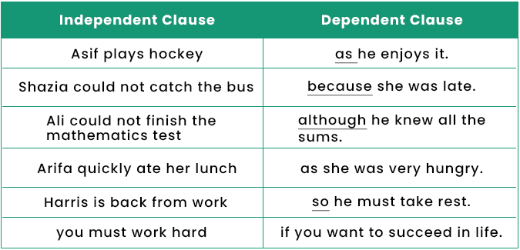

Slide 10
TYPES OF DEPENDENT CLAUSES
SUBORDINATE CLAUSE
It begins with a subordinating conjunction like after, although, as, if, when, where, because etc.
Although she was in pain, she stayed in game.
She stayed in game because she was needed.
RELATIVE CLAUSE
It begins with a relative pronoun like That, Which or Who. Relative pronouns relate the clause to another word in sentence.
The snow that fell last night is nearly gone.
Sana was only one who stayed in the game.

Slide 11
ACTIVITY IS ON PAGE NUMBER 5,6 AND 7

Slide 12
SENTENCES
A sentence is a set of words that is complete in itself, typically containing a subject and verb, conveying a statement, question, exclamation, or command, and consisting of a main clause and sometimes one or more subordinate clauses or phrases.
For Example:
Francis goes to church every day.
Robert lives in the nearby village.

Slide 13
SENTENCE TYPE
Declarative
Interrogative
Imperative
Exclamatory

Slide 14
Declarative Sentence:
It used to express statements. It can be positive or negative.
The hat only cost me $15.
I don’t really want to be here.
Interrogative Sentence:
It is used to ask questions
What will happen in December 2025?
Did you have a class yesterday?
Imperative Sentence:
It is used to give orders, directions, to request, etc.
Give me a marker
Switch it off
Exclamatory Sentence:
It is used to express opinions, feelings with force and strong emotions.
What a wonderful idea!
Get out!

Slide 15
ACTIVITY: Identify the sentence functional types of the following.
1. Give the orange juice to Cecilia.
2. How sleepy I am!
3. What a funny dream I had last night!
4. I can hardly wait for the dance!
5. Please don’t talk so loudly.
6. Tell Ali that it’s time to get up.
7. Put the timer where you’ll be sure to see it.
8. I love peanut butter sandwiches.
9. The toast is burning!
10. Give this bottle to the baby.

